Slide 1
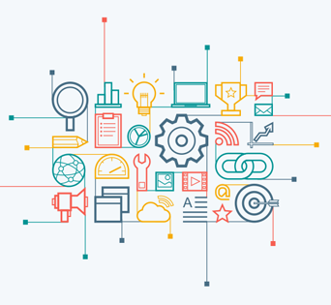
Social Media Analytics
BAIT 508 PROJECT
October 2018
Submitted by:
Atlas Quan (91489393, prateekj29@gmail.com)
Kinjal Majumdar (91489393, prateekj29@gmail.com)
Prateek Jain (91489393, prateekj29@gmail.com)

Slide 2



Content
Procedure and Analysis: This includes, how the data was obtained from Twitter, what were the key words used to conduct analysis, and the procedure for every analysis performed.
Results: Our findings from the conducted analysis conducted
Insights: Understanding the results and generating deep meaningful relationship between the tweets.

Slide 3





Procedure and Analysis
The four steps involved are:
Data Collection:
Preliminary Analysis:
Word Cloud:
Sentiment Analysis:

Slide 4
Data collection

Slide 5
Preliminary Analysis – Methodology & Code
Methodology:

Slide 6
Preliminary Analysis - Results
a. Top ten most popular words with and without stop words for Messi and Neymar

Slide 7
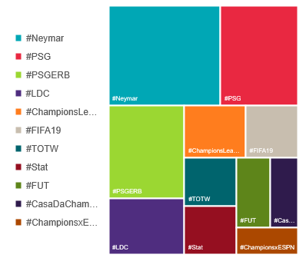
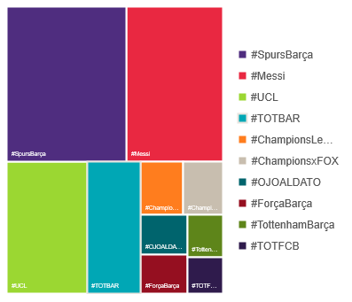
Preliminary Analysis - Results
b. Ten most popular hashtags (#hashtag)
For Messy
For Neymar

Slide 8
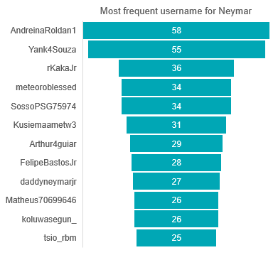
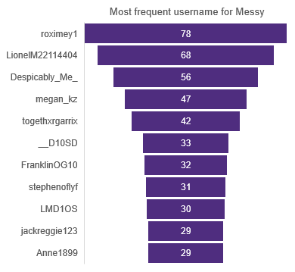
Preliminary Analysis - Results
c. Ten most frequently mentioned usernames (@username)
d. the most frequently tweeting person (tweet author) about the keyword:
Most frequent username

Slide 9
Preliminary Analysis - Results
e. the most influential tweet (the sum of retweet count, reply count, favorite and quote count)

Slide 10
Word Cloud - Methodology & Code
Methodology:

Slide 11
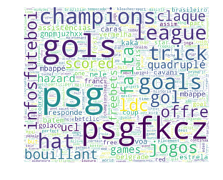
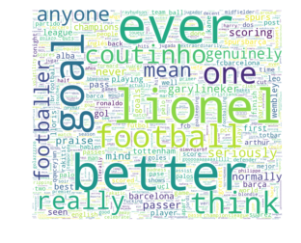
Word Cloud - Results

Slide 12
Sentiment Analysis
Methodology:

Slide 13
Insights
Overview:
There were certain salient points that were highlighted by our analyses. They were:
The most popular hashtags with regard to both Lionel Messi and Neymar involved their respective football clubs, FC Barcelona and PSG. It is interesting to note that both clubs were in action on the day of our analyses and had secured convincing victories in which both players had scored goals.
We also noticed that Lionel Messi’s popularity as the Greatest Player of All Time (GOAT) was a common sentiment echoed by a large base of Tweeters on the global level. It is interesting to note that Messi edged out Neymar in Tweet appearances, even though Neymar bagged a hatrick in his game! Our most frequently appearing user’s subject matter was also Messi. Clearly, Messi commands a very loyal fan base as well as a global level of respect.
We can also say that the significance of timing makes a big difference. Our analysis was fresh on the heels of a champions league match, and the champions league commands a fervent and passionate following as compared to league matches. It was evident in the club related tweets concerning each player that the timing of the champions league match and the performance of the player, stirred up a strong degree of football fever, rivalry and enthusiasm.

Slide 14

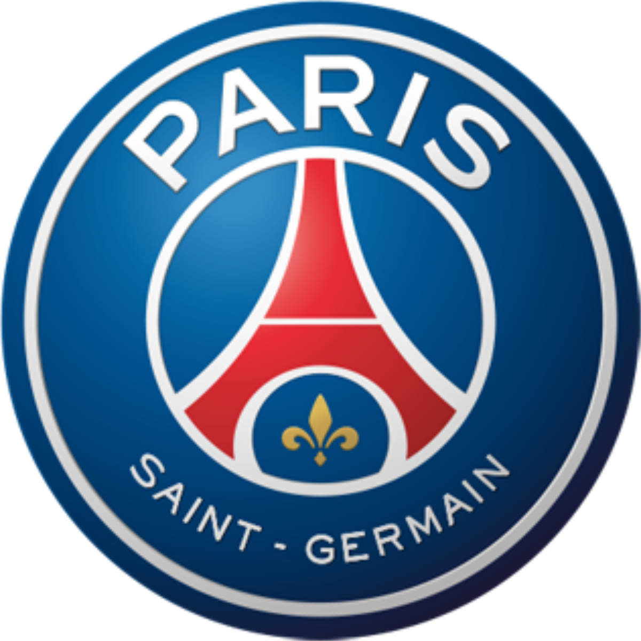
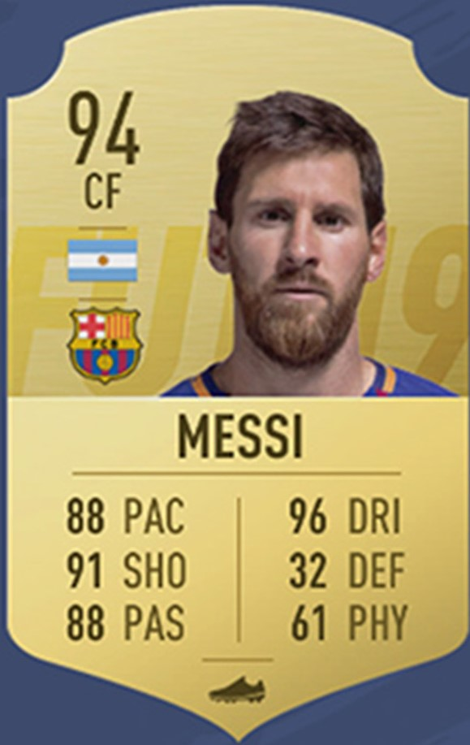
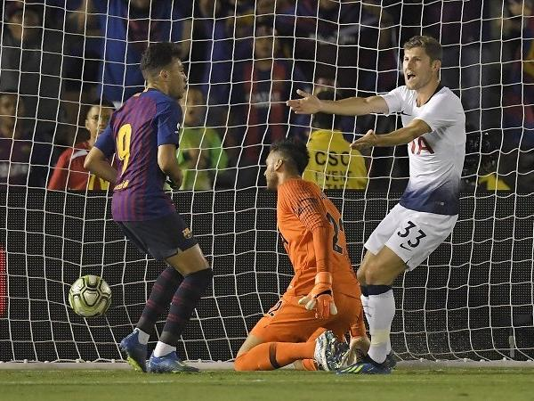
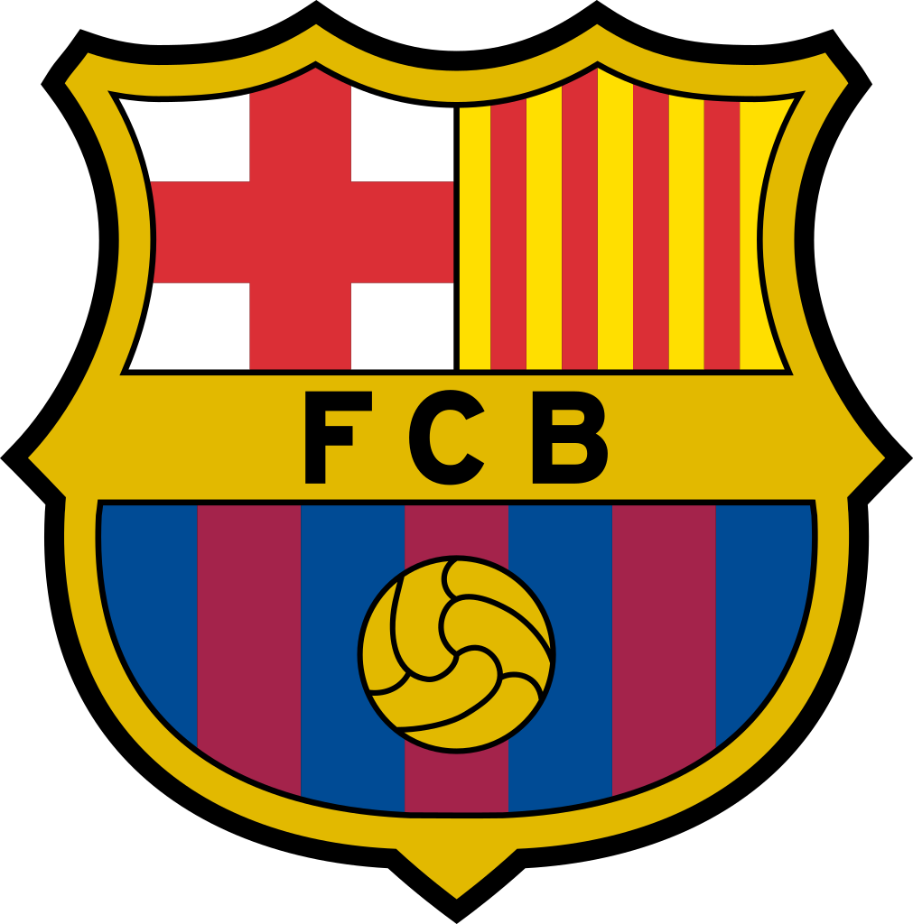
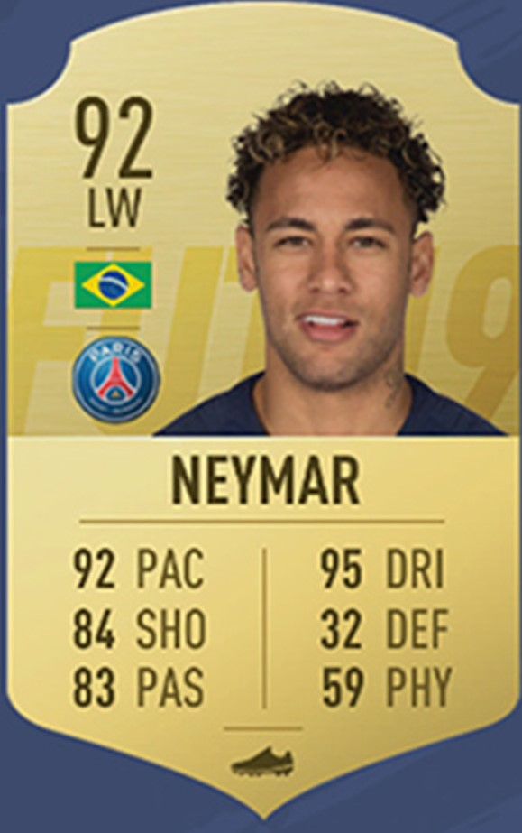
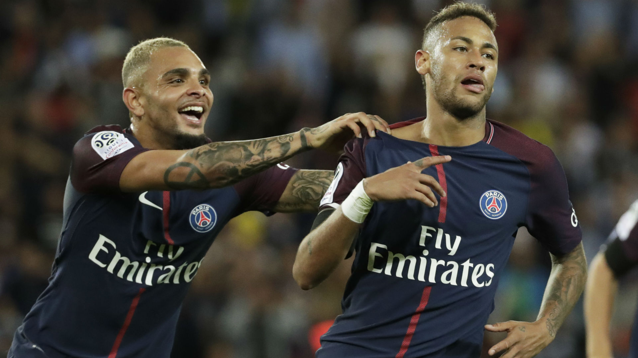
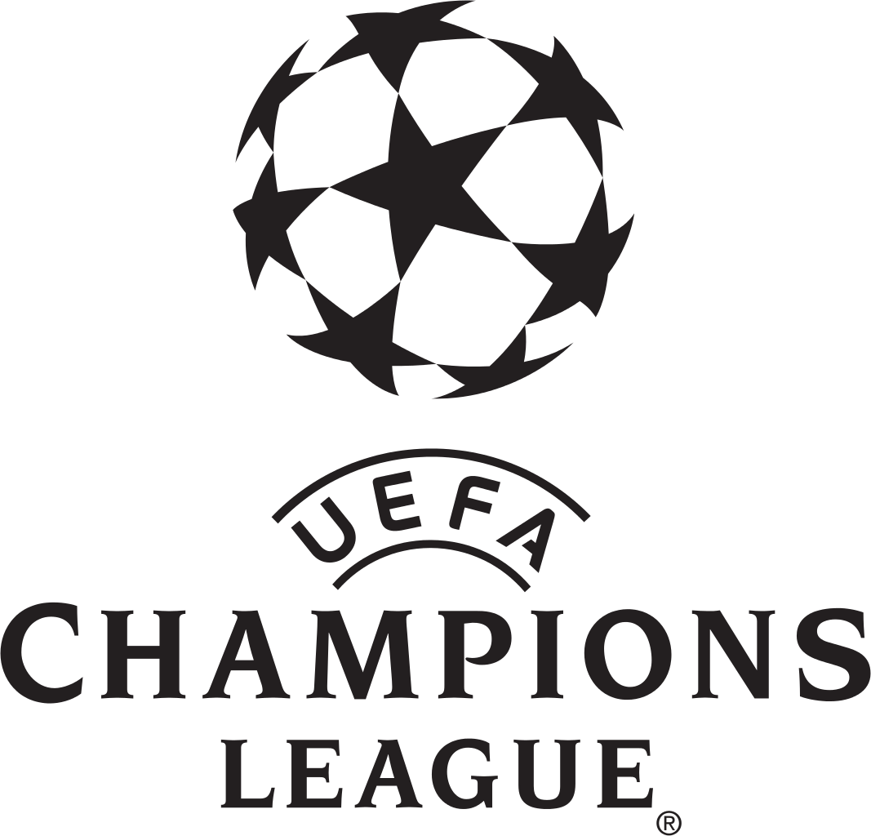
Insights
What’s on their mind?
GOAT

